Slide 1
Module 3.1:
Process Synchronization

Slide 2
Process Synchronization
Background
The Critical-Section Problem
Peterson’s Solution
Synchronization Hardware
Mutex Locks
Semaphores
Classic Problems of Synchronization
Monitors
Synchronization Examples
Alternative Approaches

Slide 3
Objectives
To present the concept of process synchronization.
To introduce the critical-section problem, whose solutions can be used to ensure the consistency of shared data
To present both software and hardware solutions of the critical-section problem
To examine several classical process-synchronization problems
To explore several tools that are used to solve process synchronization problems

Slide 4
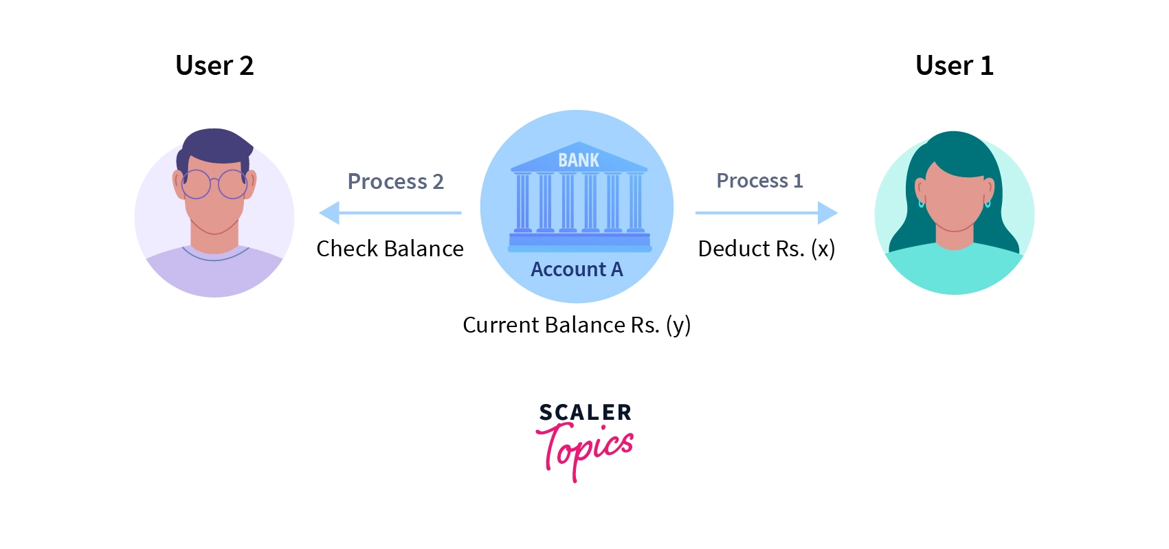
Example
Example: Train Booking via IRCTC

Slide 5
Difficulties of Concurrency
Sharing of global resources – coordinated access to shared resources
Operating system managing the allocation of resources optimally – do we know the future behaviour (needed resources) of processes?
Difficult to locate programming errors

Slide 6
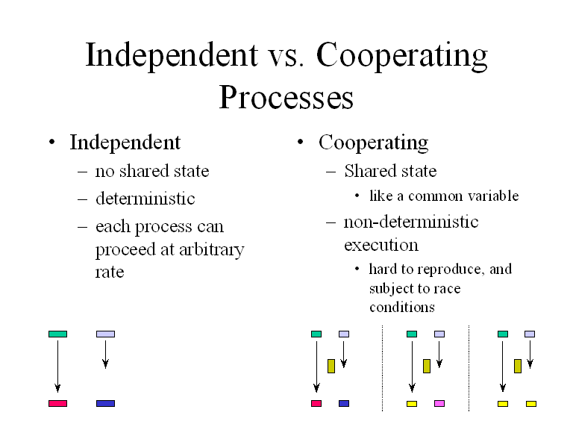

Slide 7
A Simple Example for Two Processes
Process P1 Process P2
. .
chin = getchar(); .
. chin = getchar();
chout = chin; .
chout = chin;
putchar(chout); .
. putchar(chout);
. .

Slide 8

Race Conditions
Two processes want to access shared memory at the same time.
The final result depends on who runs precisely when.
A Race condition is a scenario that occurs in a multithreaded environment due to multiple threads sharing the same resource or executing the same piece of code.

Slide 9
Critical Section Problem
Consider system of n processes {p₀, p₁, … p_{n-1}}
Each process has critical section segment of code
  Process may be changing common variables, updating table, writing file, etc
  When one process in critical section, no other may be in its critical section
Critical section problem is to design protocol to solve this
Each process must ask permission to enter critical section in entry section, may follow critical section with exit section, then remainder section

Slide 10

Critical Section
General structure of process P_{i}
Synchronization mechanisms allow the processes to access critical section in a synchronized manner to avoid the inconsistent results.

Slide 11

Critical Regions
Mutual exclusion using critical regions

Slide 12
Solution to Critical-Section Problem
1. Mutual Exclusion - If process P_{i} is executing in its critical section, then no other processes can be executing in their critical sections
2. Progress - If no process is executing in its critical section and there exist some processes that wish to enter their critical section, then the selection of the processes that will enter the critical section next cannot be postponed indefinitely
3. Bounded Waiting - A bound must exist on the number of times that other processes are allowed to enter their critical sections after a process has made a request to enter its critical section and before that request is granted
  Assume that each process executes at a nonzero speed
  No assumption concerning relative speed of the n processes
  4. Architectural Neutral- There is no dependency on the architecture.

Slide 13
Critical-Section Handling in OS
Two approaches depending on if kernel is preemptive or non- preemptive
  Preemptive – allows preemption of process when running in kernel mode
  Non-preemptive – runs until exits kernel mode, blocks, or voluntarily yields CPU
    Essentially free of race conditions in kernel mode

Slide 14
Algorithm for Process P_{i}
do {
while (turn == j);
critical section
turn = j;
remainder section
} while (true);

Slide 15

Software Solutions

Slide 16
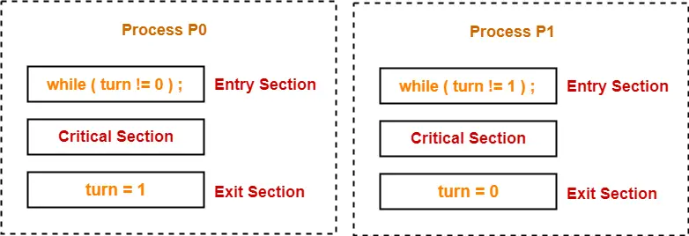
Turn variable
Turn variable is a synchronization mechanism that provides synchronization among two processes.
Initially, turn value is set to 0.
Turn value = 0 means it is the turn of process P₀ to enter the critical section.
Turn value = 1 means it is the turn of process P₁ to enter the critical section.

Slide 17
Peterson’s Solution
Good algorithmic description of solving the problem
Two process solution
Assume that the load and store machine-language instructions are atomic; that is, cannot be interrupted
The two processes share two variables:
  int turn;
  Boolean flag[2]
The variable turn indicates whose turn it is to enter the critical section
The flag array is used to indicate if a process is ready to enter the critical section. flag[i] = true implies that process P_{i} is ready!

Slide 18
Algorithm for Process P_{i}
do {
flag[i] = true;
turn = j;
while (flag[j] && turn = = j);
critical section
flag[i] = false;
remainder section
} while (true);

Slide 19
Algorithm for Process P_{j}
do {
flag[j] = true;
turn = i;
while (flag[i] && turn = = i);
critical section
flag[j] = false;
remainder section
} while (true);

Slide 20
2 Process: Pi and Pj
For process Pi
For process Pj
do {
flag[i] = true;
turn = j;
while (flag[j] && turn = = j);
critical section
flag[i] = false;
remainder section
} while (true);
do {
flag[j] = true;
turn = i;
while (flag[i] && turn = = i);
critical section
flag[j] = false;
remainder section
} while (true);

Slide 21
Peterson’s Solution (Cont.)
Provable that the three CS requirement are met:
1. Mutual exclusion is preserved
P_{i} enters CS only if:
either flag[j] = false or turn = i
2. Progress requirement is satisfied
3. Bounded-waiting requirement is met

Slide 22
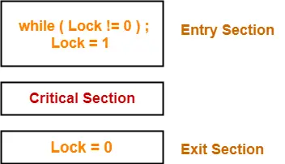
Lock variable
A lock variable provides the simplest synchronization mechanism for processes.
Its a software mechanism implemented in user mode, i.e. no support required from the Operating System.
Its a busy waiting solution (keeps the CPU busy even when its technically waiting).
It can be used for more than two processes.
When Lock = 0 implies critical section is vacant (initial value ) and Lock = 1 implies critical section occupied.

Slide 23
Lock variable
Every Synchronization mechanism is judged on the basis of three primary parameters :
1) Mutual Exclusion.
2) Progress.
3) Bounded Waiting.
Of which mutual exclusion is the most important of all parameters.
The Lock Variable doesn’t provide mutual exclusion in some cases.

Slide 24
Semaphore
Synchronization tool that provides more sophisticated ways (than Mutex locks) for process to synchronize their activities.
Semaphore S – integer variable
Can only be accessed via two indivisible (atomic) operations
  wait() and signal()
    Originally called P() and V()
    Note:
    P operation is also called wait, sleep, or down operation, and V operation is also called signal, wake-up, or up operation.

Slide 25
Semaphore
Definition of the wait() operation
Definition of the signal() operation
  wait(S) {
  while (S <= 0)
  ; //busy wait
  S--;
  signal(S) {
  S++;
  }

Slide 26
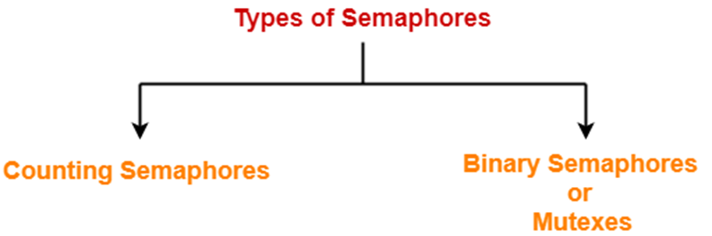
Types of Semaphore
Counting semaphore – integer value can range over an unrestricted domain
Binary semaphore – integer value can range only between 0 and 1
  Same as a mutex lock

Slide 27
Semaphore Usage
Can solve various synchronization problems
Consider P₁ and P₂ that require S₁ to happen before S₂
Create a semaphore “synch” initialized to 0
  P1:
  S₁;
  signal(synch);
  P2:
  wait(synch);
  S₂;
Can implement a counting semaphore S as a binary semaphore

Slide 28
PRACTICE PROBLEMS: GATE CS
Each process Pi, i = 1, 2, …, 9 is coded as follows-
repeat
P(mutex)
{ Critical Section }
V(mutex)
Forever
The code for P₁₀ is identical except that it uses V(mutex) in place of P(mutex). What is the largest number of processes that can be inside the critical section at any moment?
1
2
3
None of these

Slide 29
Practice Problems
A counting semaphore S is initialized to 10. Then, 6 P operations and 4 V operations are performed on S. What is the final value of S?
Final value of semaphore variable S
= 10 – (6 x 1) + (4 x 1)
= 10 – 6 + 4

Slide 30
Practice Problems
The following program consists of 3 concurrent processes and 3 binary semaphores. The semaphores are initialized as S0 = 1, S1 = 0 and S2 = 0.
Process P0 | Process P1 | Process P2
while (true) { wait (S0); print ‘0’ release (S1); release (S2); } | wait (S1); release (S0); | wait (S2); release (S0);

Slide 31
Classical Problems of Synchronization
Classical problems used to test newly-proposed synchronization schemes
  Bounded-Buffer Problem
  Readers and Writers Problem
  Dining-Philosophers Problem

Slide 32
Producer
while (true) {
/* produce an item in next produced */
while (counter == BUFFER_SIZE) ;
/* do nothing */
buffer[in] = next_produced;
in = (in + 1) % BUFFER_SIZE;
counter++;
}

Slide 33
Consumer
while (true) {
while (counter == 0)
; /* do nothing */
next_consumed = buffer[out];
out = (out + 1) % BUFFER_SIZE;
counter--;
/* consume the item in next consumed */
}

Slide 34
Race Condition
counter++ could be implemented as
register1 = counter
register1 = register1 + 1
counter = register1
counter-- could be implemented as
register2 = counter
register2 = register2 - 1
counter = register2
Consider this execution interleaving with “count = 5” initially:
  S0: producer execute register1 = counter {register1 = 5}
  S1: producer execute register1 = register1 + 1 {register1 = 6}
  S2: consumer execute register2 = counter {register2 = 5}
  S3: consumer execute register2 = register2 – 1 {register2 = 4}
  S4: producer execute counter = register1 {counter = 6 }
  S5: consumer execute counter = register2 {counter = 4}

Slide 35
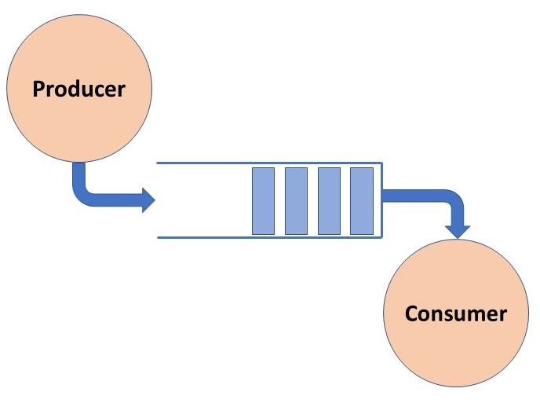
Bounded-Buffer Problem: Solution
n buffers, each can hold one item
Semaphore mutex initialized to the value 1
Semaphore full initialized to the value 0
Semaphore empty initialized to the value n

Slide 36
Solution using semaphore
Problem Statement –
We have a buffer of fixed size. A producer can produce an item and can place in the buffer. A consumer can pick items and can consume them. We need to ensure that when a producer is placing an item in the buffer, then at the same time consumer should not consume any item. In this problem, buffer is the critical section.

Slide 37
Bounded Buffer Problem (Cont.)
The structure of the producer process
do {
...
/* produce an item in next_produced */
...
wait(empty);
wait(mutex);
...
/* add next produced to the buffer */
...
signal(mutex);
signal(full);
} while (true);

Slide 38
Bounded Buffer Problem (Cont.)
The structure of the consumer process
Do {
wait(full);
wait(mutex);
...
/* remove an item from buffer to next_consumed */
...
signal(mutex);
signal(empty);
...
/* consume the item in next consumed */
...
} while (true);

Slide 39
Readers-Writers Problem
A data set is shared among a number of concurrent processes
  Readers – only read the data set; they do not perform any updates
  Writers – can both read and write
Problem – allow multiple readers to read at the same time
  Only one single writer can access the shared data at the same time
Several variations of how readers and writers are considered – all involve some form of priorities
Shared Data
  Data set
  Semaphore wrt initialized to 1
  Semaphore mutex initialized to 1
  Integer read_count initialized to 0

Slide 40
Readers-Writers Problem (Cont.)
The structure of a writer process
do {
wait(wrt);
...
/* writing is performed */
...
signal(wrt);
} while (true);

Slide 41
Readers-Writers Problem (Cont.)
The structure of a reader process
do {
wait(mutex);
read_count++;
if (read_count == 1)
wait(wrt);
signal(mutex);
...
/* reading is performed */
...
wait(mutex);
read count--;
if (read_count == 0)
signal(wrt);
signal(mutex);
} while (true);

Slide 42
Readers-Writers Problem Variations
First variation – no reader kept waiting unless writer has permission to use shared object
Second variation – once writer is ready, it performs the write ASAP
Both may have starvation leading to even more variations
Problem is solved on some systems by kernel providing reader-writer locks

Slide 43

Dining-Philosophers Problem
Philosophers spend their lives alternating thinking and eating
Don’t interact with their neighbors, occasionally try to pick up 2 chopsticks (one at a time) to eat from bowl
  Need both to eat, then release both when done
In the case of 5 philosophers
  Shared data
    Bowl of rice (data set)
    Semaphore chopstick [5] initialized to 1

Slide 44
Dining-Philosophers Problem Algorithm
The structure of Philosopher i:
    do {
    wait (chopstick[i] );
    wait (chopStick[ (i + 1) % 5] );
    // eat
    signal (chopstick[i] );
    signal (chopstick[ (i + 1) % 5] );
    // think
    } while (TRUE);
What is the problem with this algorithm?

Slide 45
Dining-Philosophers Problem Algorithm (Cont.)
Deadlock handling
  Allow at most 4 philosophers to be sitting simultaneously at the table.
  Allow a philosopher to pick up the forks only if both are available (picking must be done in a critical section.
  Use an asymmetric solution -- an odd-numbered philosopher picks up first the left chopstick and then the right chopstick. Even-numbered philosopher picks up first the right chopstick and then the left chopstick.

Slide 46
Problems with Semaphores
Incorrect use of semaphore operations:
  signal (mutex) …. wait (mutex)
  wait (mutex) … wait (mutex)
  Omitting of wait (mutex) or signal (mutex) (or both)
Deadlock and starvation are possible.

Slide 47
Monitors
A high-level abstraction that provides a convenient and effective mechanism for process synchronization
Abstract data type, internal variables only accessible by code within the procedure
Only one process may be active within the monitor at a time
But not powerful enough to model some synchronization schemes

Slide 48
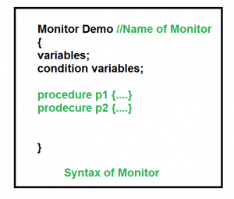
Monitors

Slide 49

Schematic view of a Monitor

Slide 50
Condition Variables
condition x, y;
Two operations are allowed on a condition variable:
  x.wait() – a process that invokes the operation is suspended until x.signal()
  x.signal() – resumes one of processes (if any) that invoked x.wait()
    If no x.wait() on the variable, then it has no effect on the variable

Slide 51

Monitor with Condition Variables

Slide 52
Condition Variables Choices
If process P invokes x.signal(), and process Q is suspended in x.wait(), what should happen next?
  Both Q and P cannot execute in paralel. If Q is resumed, then P must wait
Options include
  Signal and wait – P waits until Q either leaves the monitor or it waits for another condition
  Signal and continue – Q waits until P either leaves the monitor or it waits for another condition
  Both have pros and cons – language implementer can decide
  Monitors implemented in Concurrent Pascal compromise
    P executing signal immediately leaves the monitor, Q is resumed
  Implemented in other languages including Mesa, C#, Java

Slide 53
Monitor Solution to Dining Philosophers
monitor DiningPhilosophers
{
enum { THINKING; HUNGRY, EATING) state [5] ;
condition self [5];
void pickup (int i) {
state[i] = HUNGRY;
test(i);
if (state[i] != EATING) self[i].wait;
}
void putdown (int i) {
state[i] = THINKING;
// test left and right neighbors
test((i + 4) % 5);
test((i + 1) % 5);
}

Slide 54
Solution to Dining Philosophers (Cont.)
void test (int i) {
if ((state[(i + 4) % 5] != EATING) &&
(state[i] == HUNGRY) &&
(state[(i + 1) % 5] != EATING) ) {
state[i] = EATING ;
self[i].signal () ;
}
}
initialization_code() {
for (int i = 0; i < 5; i++)
state[i] = THINKING;
}
}

Slide 55
Solution to Dining Philosophers (Cont.)
Each philosopher i invokes the operations pickup() and putdown() in the following sequence:
DiningPhilosophers.pickup(i);
EAT
DiningPhilosophers.putdown(i);
No deadlock, but starvation is possible

Slide 56
Monitor Implementation Using Semaphores
Variables
semaphore mutex; // (initially = 1)
semaphore next; // (initially = 0)
int next_count = 0;
Each procedure F will be replaced by
wait(mutex);
…
body of F;
…
if (next_count > 0)
signal(next)
else
signal(mutex);
Mutual exclusion within a monitor is ensured

Slide 57
Monitor Implementation – Condition Variables
For each condition variable x, we have:
semaphore x_sem; // (initially = 0)
int x_count = 0;
The operation x.wait can be implemented as:
x_count++;
if (next_count > 0)
signal(next);
else
signal(mutex);
wait(x_sem);
x_count--;

Slide 58
Monitor Implementation (Cont.)
The operation x.signal can be implemented as:
if (x_count > 0) {
next_count++;
signal(x_sem);
wait(next);
next_count--;
}

Slide 59
Resuming Processes within a Monitor
If several processes queued on condition x, and x.signal() executed, which should be resumed?
FCFS frequently not adequate
conditional-wait construct of the form x.wait(c)
  Where c is priority number
  Process with lowest number (highest priority) is scheduled next

Slide 60
Mutex Locks
Previous solutions are complicated and generally inaccessible to application programmers
OS designers build software tools to solve critical section problem
Simplest is mutex lock
Protect a critical section by first acquire() a lock then release() the lock
  Boolean variable indicating if lock is available or not
Calls to acquire() and release() must be atomic
  Usually implemented via hardware atomic instructions
But this solution requires busy waiting
  This lock therefore called a spinlock

Slide 61
acquire() and release()
acquire() {
while (!available)
; /* busy wait */
available = false;
}
release() {
available = true;
}
do {
acquire lock
critical section
release lock
remainder section
} while (true);

Slide 62
Semaphore Implementation
Must guarantee that no two processes can execute the wait() and signal() on the same semaphore at the same time
Thus, the implementation becomes the critical section problem where the wait and signal code are placed in the critical section
  Could now have busy waiting in critical section implementation
    But implementation code is short
    Little busy waiting if critical section rarely occupied
Note that applications may spend lots of time in critical sections and therefore this is not a good solution

Slide 63
Deadlock and Starvation
Deadlock – two or more processes are waiting indefinitely for an event that can be caused by only one of the waiting processes
Let S and Q be two semaphores initialized to 1
P₀ P₁
wait(S); wait(Q);
wait(Q); wait(S);
... ...
signal(S); signal(Q);
signal(Q); signal(S);
Starvation – indefinite blocking
  A process may never be removed from the semaphore queue in which it is suspended
Priority Inversion – Scheduling problem when lower-priority process holds a lock needed by higher-priority process
  Solved via priority-inheritance protocol

Slide 64
Synchronization Hardware
Many systems provide hardware support for implementing the critical section code.
All solutions below based on idea of locking
  Protecting critical regions via locks
Uniprocessors – could disable interrupts
  Currently running code would execute without preemption
  Generally too inefficient on multiprocessor systems
    Operating systems using this not broadly scalable
Modern machines provide special atomic hardware instructions
    Atomic = non-interruptible
  Either test memory word and set value
  Or swap contents of two memory words

Slide 65
test_and_set Instruction
Definition:
boolean test_and_set (boolean *target)
{
boolean rv = *target;
*target = TRUE;
return rv:
}
Executed atomically
Returns the original value of passed parameter
Set the new value of passed parameter to “TRUE”.

Slide 66
Solution using test_and_set()
Shared Boolean variable lock, initialized to FALSE
Solution:
do {
while (test_and_set(&lock))
; /* do nothing */
/* critical section */
lock = false;
/* remainder section */
} while (true);

Slide 67
Bounded-waiting Mutual Exclusion with test_and_set
do {
waiting[i] = true;
key = true;
while (waiting[i] && key)
key = test_and_set(&lock);
waiting[i] = false;
/* critical section */
j = (i + 1) % n;
while ((j != i) && !waiting[j])
j = (j + 1) % n;
if (j == i)
lock = false;
else
waiting[j] = false;
/* remainder section */
} while (true);

Slide 68
Synchronization Examples
Solaris
Windows
Linux
Pthreads

Slide 69
Windows Synchronization
Uses interrupt masks to protect access to global resources on uniprocessor systems
Uses spinlocks on multiprocessor systems
  Spinlocking-thread will never be preempted
Also provides dispatcher objects user-land which may act mutexes, semaphores, events, and timers
  Events
    An event acts much like a condition variable
  Timers notify one or more thread when time expired
  Dispatcher objects either signaled-state (object available) or non-signaled state (thread will block)

Slide 70
End of Chapter

